Slide 1
PROJECT TITTLE
BITE EASYFOOD ORDERING APP
APPLICATION NAME : BITE EASY
BY TEAM MEMBERS
R.AARTHEESWARI
P.AKSHAYA HARITHA
A.S.SAI SRUTHI
K.ANBARASI

Slide 2
ABSTRACT:
The SB Foods Food Ordering App is a user-friendly platform designed to revolutionize how users order food online. Built using the MERN stack (MongoDB, Express, React, Node.js), this app allows users to explore a variety of dishes, place orders, and get them delivered quickly, with minimal effort. The app's key feature is its ability to cater to specific user needs, such as fulfilling late-night cravings by showing restaurants that remain open during non-standard hours. The project aims to deliver a seamless and efficient food ordering experience, offering a convenient solution for busy customers.

Slide 3
INTRODUCTION
The modern food industry demands innovative solutions to meet the growing need for fast, efficient, and convenient food delivery services. Bite Easy addresses this demand by allowing users to place orders online, track deliveries, and receive meals without any hassle. Leveraging a clean and responsive interface, users can easily browse through different categories of dishes, customize their orders, and enjoy an intuitive checkout process. The app ensures quality service and timely delivery, providing a smooth experience from order placement to receiving the food.

Slide 4
PROPOSED SYSTEM:
User Interface: A visually appealing, responsive UI that helps users discover, select, and order meals effortlessly.
Dish Selection and Customization: Users can choose from a wide range of dishes and customize their orders based on preferences.
Real-Time Order Tracking: Users receive notifications and real-time updates on their order status, ensuring transparency and convenience.
Late-Night Availability: The app highlights restaurants that offer late-night services, helping users satisfy cravings during odd hours.

Slide 5
Secure Payments and Order Confirmation: Users can pay securely using multiple payment gateways, with real-time order confirmation.
Admin Dashboard: Admin users can manage the platform, update restaurant and dish details, and monitor orders and deliveries.

Slide 6
TECHNICAL ARCHITECTURE
Frontend (React): User interface components such as User Authentication, Cart, Profile, and Order Management.
Backend (Node.js, Express): API endpoints for Users, Orders, and Products with Admin Authentication.
Database (MongoDB): Storing collections for Users, Orders, Admins, Products, and Carts.

Slide 7
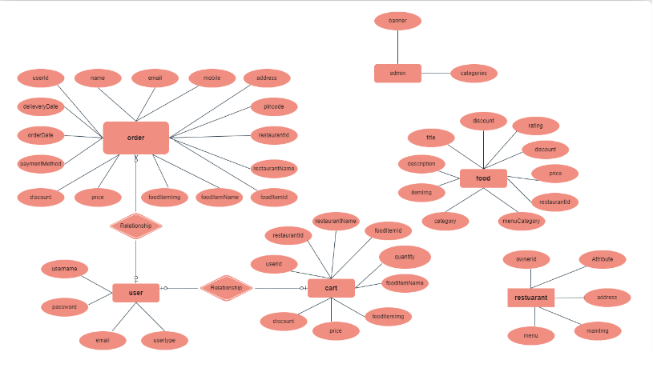
FLOW CHART

Slide 8
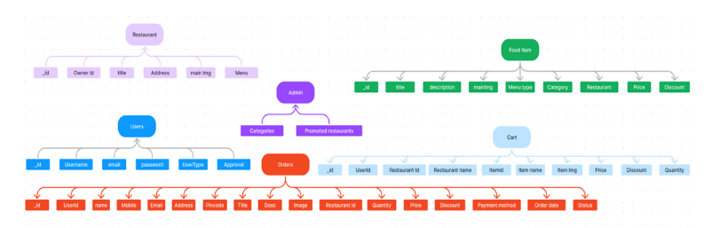

Slide 9
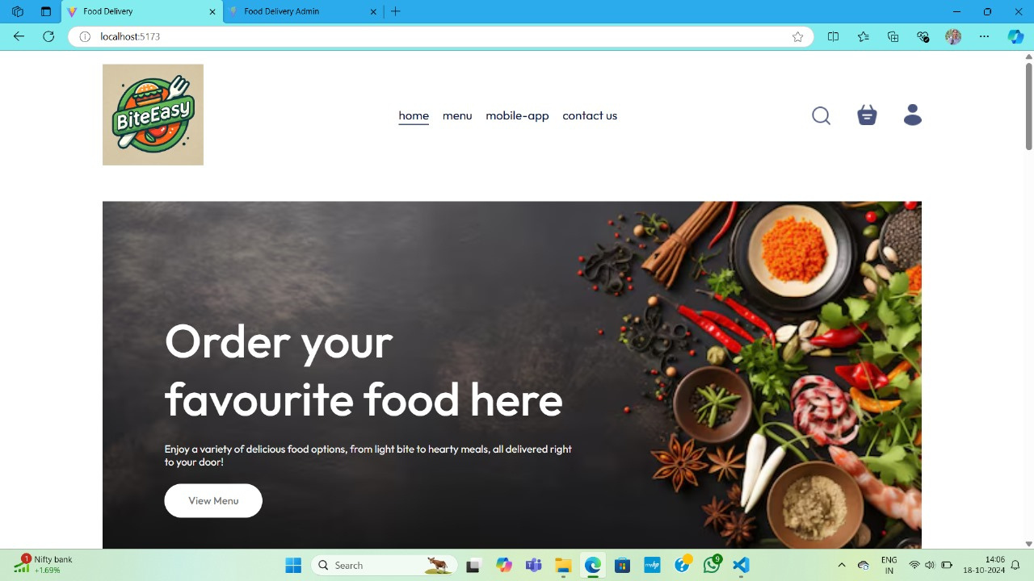
STEP 1: BROWSE AND PICK A RESTAURANT BASED ON YOUR PREFERENCE.

Slide 10
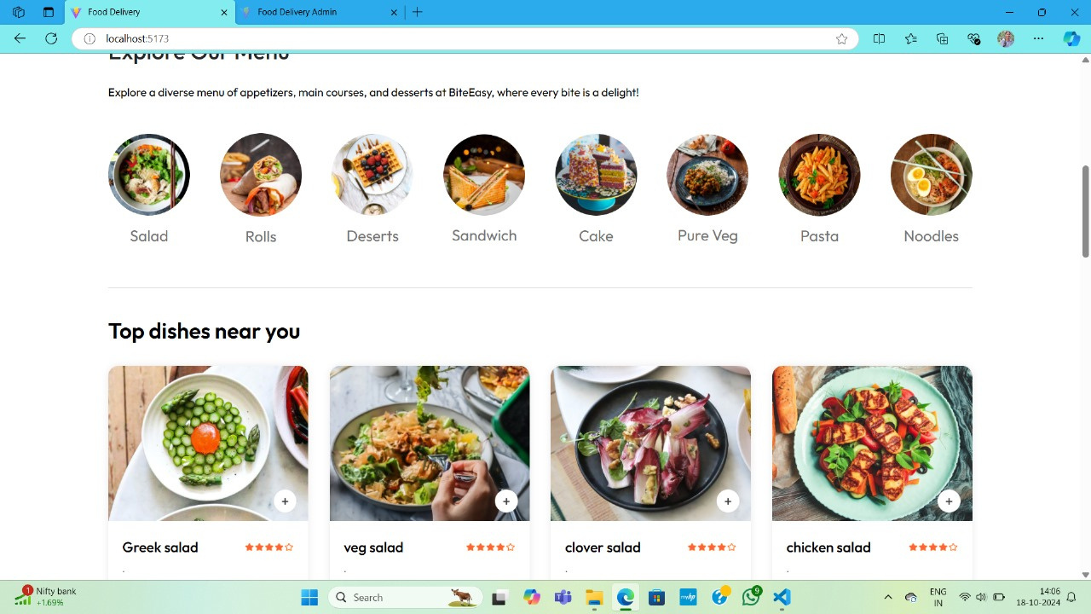
STEP 2: CHOOSE YOUR DISH – SELECT YOUR FAVORITE DISHES FROM THE MENU.

Slide 11
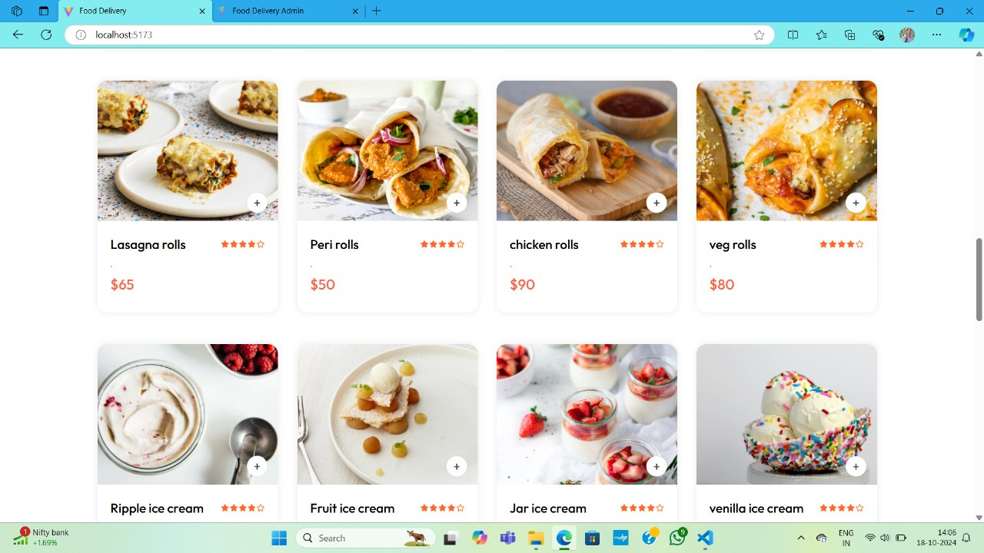

Slide 12
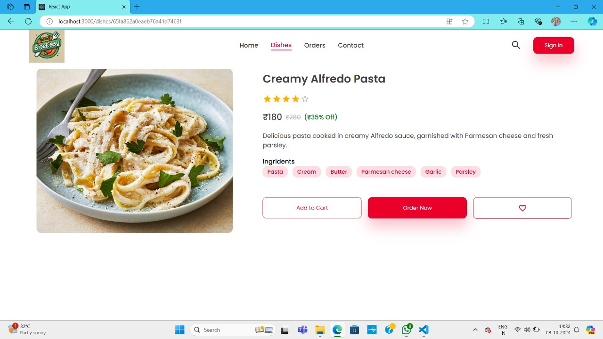
STEP 4: ADD TO CART AND CHECKOUT – ADD ITEMS TO YOUR CART, ENTER YOUR DELIVERY DETAILS, AND CHOOSE A PAYMENT METHOD.

Slide 13
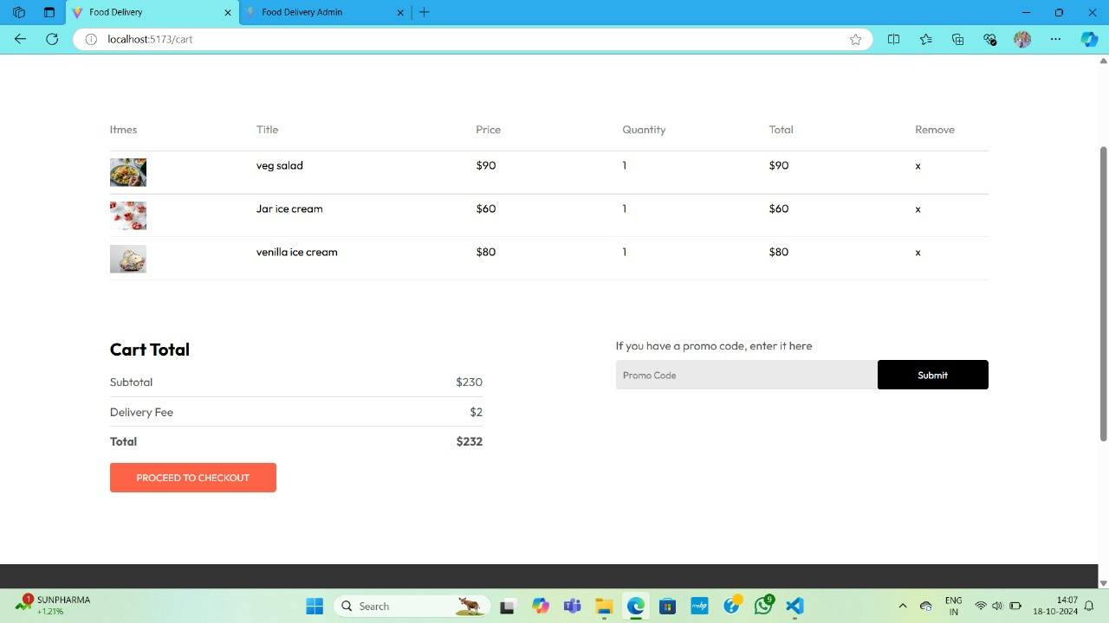

Slide 14
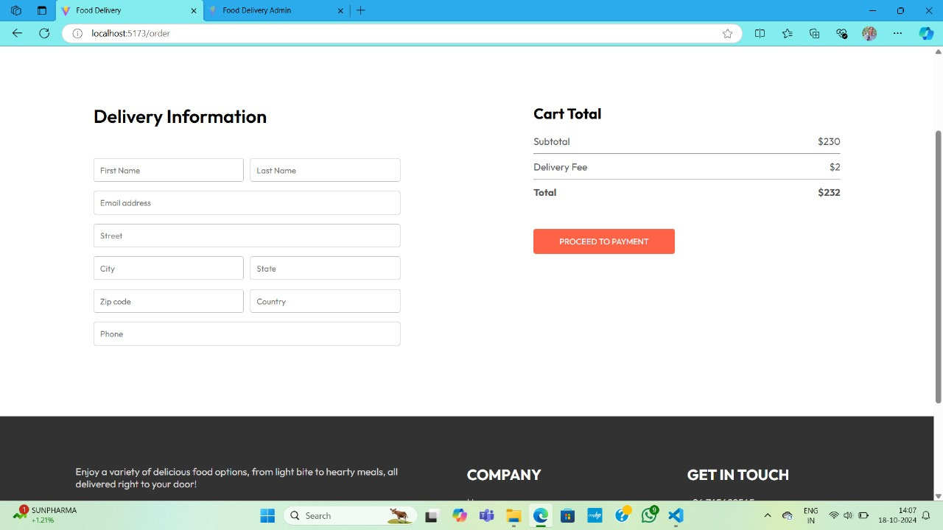

Slide 15
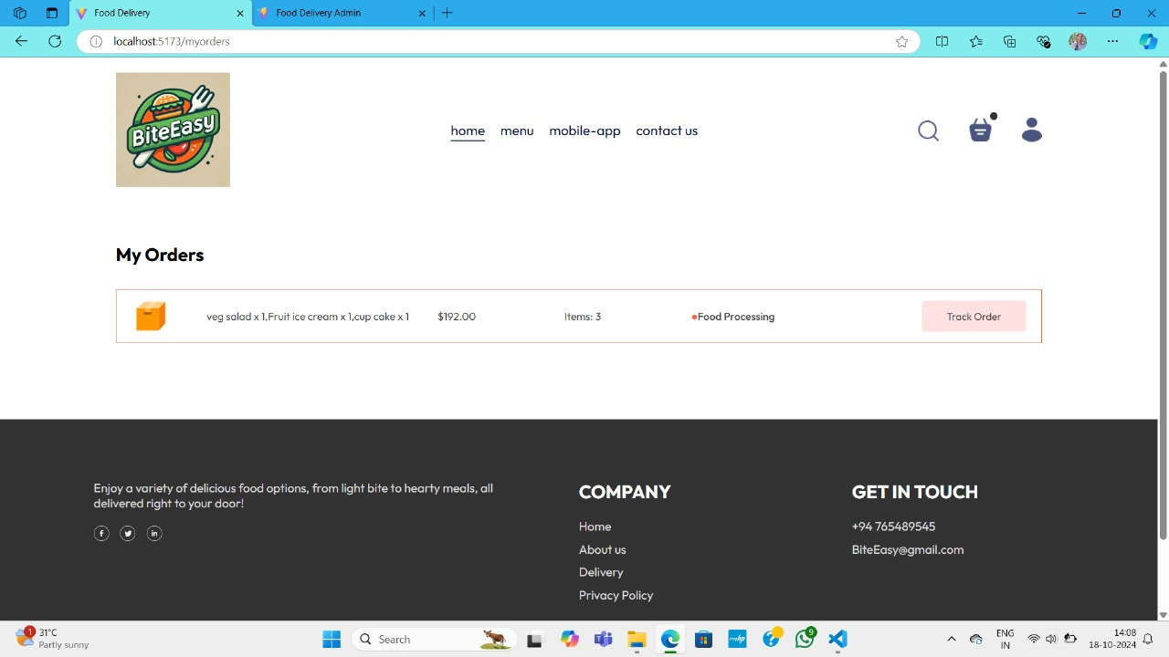

Slide 16
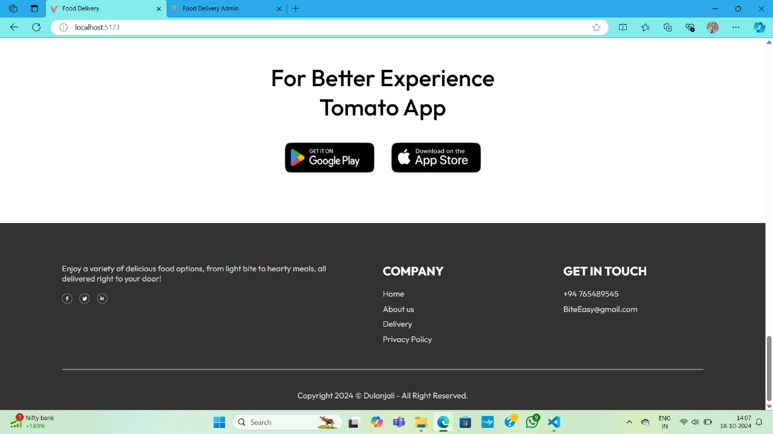

Slide 17
CONCLUSION
The SB Foods Food Ordering App successfully provides an efficient solution to the online food ordering process, particularly catering to the needs of customers with late-night cravings. The app simplifies the process of discovering dishes, placing orders, and receiving deliveries with an intuitive interface and seamless backend integration. By incorporating features like secure payments, real-time order tracking, and customizable dish options, the SB Foods app is a convenient, user-centric solution that ensures a hassle-free food ordering experience.

Slide 18


